Slide 1
Deploying Analytics Using Excel & APIs
Learn how to bridge the gap between Python analytics and business users through Excel-based API integration.

Slide 2
Contents
01
02
03
Why Use Excel as a Frontend?
Overall System Architecture
Case Study: Stock Analytics API
Business case and core advantages of Excel as a BI layer
How Excel, FastAPI, and Python fit together end-to-end
Data preparation, metric calculation, and API development
04
05
Excel Integration & Visualization
Advantages & Key Takeaways
Triggering APIs from Excel, live refresh, charts, and automation
Benefits for data teams, business users, and organizations

Slide 3
Why Use Excel as a Frontend?
Excel is already embedded in how business teams operate. Rather than asking users to adopt new tools, exposing analytics through Excel meets them where they are — combining Python's computational power with a familiar interface.
Business User Friendly
Easy Integration
Widely adopted across industries with no coding required for end users. Analysts can consume live data without touching Python.
Connects seamlessly with APIs using Power Query, Office Scripts, and VBA — no external middleware needed.
Rich Visualization
Lightweight BI
Supports reporting, charts, pivot tables, and dashboards natively. No additional BI licensing required.
Acts as a lightweight BI interface without the complexity of Power BI or Tableau setup and governance overhead.

Slide 4





Overall System Architecture
The system follows a clean, linear flow from user interface to data processing and back. Each layer has a single responsibility, making the pipeline easy to debug, extend, and maintain.
1. Excel
2. API Request
3. FastAPI Backend
Sends request & displays output
HTTP data transmission layer
Exposes analytics endpoint
4. Python Processing
5. JSON Response
Computes stock metrics
Returns structured data to Excel
Each layer is independently replaceable — swap Excel for a web app, or FastAPI for Flask, without touching the other components.

Slide 5

CASE STUDY
Stock Analytics API
A real-world case study demonstrating FastAPI's full capabilities — from data ingestion and metric calculation to frontend integration and cloud deployment.
Step 1 & 2: Data Preparation
Step 3: API Development
Step 4: Frontend Integration
Collect 1 year of historical stock data and compute key financial metrics using yfinance and pandas. Returns, volatility, min/max, current prices via pandas for rolling one year window.
Wrap Python logic in FastAPI route decorators to convert it into a callable HTTP endpoint.
Connect an HTML + JavaScript page to fetch and display live stock data in a browser table.
Final Outcome: A complete system where users can fetch live stock insights through a web interface — fully automated, no manual scripts needed.

Slide 6
Steps 1 & 2: Data Preparation & Metric Calculation
def generate_us_stock_summary():
end_date = datetime.now().date()
start_date = end_date - timedelta(days=365)
symbols = [
"NVDA", "GOOGL", "AAPL", "MSFT", "AMZN",
"META", "AVGO", "TSLA", "ORCL", "PLTR"
]
stockdata = yf.download(
tickers=symbols,
start=start_date,
end=end_date,
progress=False
)
closeprice_df = stockdata["Close"].copy()
returns_df = closeprice_df.pct_change() * 100
summary_df = pd.DataFrame({
"Ticker": closeprice_df.columns,
"Max_Value": closeprice_df.max().values,
"Min_Value": closeprice_df.min().values,
"Current_Value": closeprice_df.iloc[-1].values,
"Avg_Daily_Return_%": returns_df.mean().values,
"Volatility_%": returns_df.std().values
})
return summary_df
Selected Tickers
NVDA · GOOGL · AAPL · MSFT · AMZN · META · AVGO · TSLA · ORCL · PLTR
Source: yfinance — 1 year of historical daily close prices.
Metrics Calculated
Minimum price over the period
Maximum price over the period
Current price (latest close)
Average daily return (%)
Volatility (standard deviation of returns)

Slide 7

Step 3: API Development using FastAPI
FastAPI wraps Python logic into accessible HTTP endpoints callable from any client — browser, mobile app, or another service. Below is the complete endpoint definition for the stock analytics API.
FastAPI Initialization Flow
from fastapi import FastAPI
app = FastAPI()
@app.get("/us-stocks")
def get_us_stock_summary():
result = generate_us_stock_summary()
return result.round(4).to_dict(
orient="records"
)
1
Create FastAPI app instance
2
Define route using @app.get decorator
3
Call the stock calculation function
4
Return results as formatted JSON
The @app.get decorator creates a GET endpoint any HTTP client can call to retrieve live stock data — fully validated and serialized automatically.

Slide 8

STEP 4
Excel Export Integration
Integration Concept
01
02
03
Excel as UI
Trigger the API Call
HTTP Request Sent
Excel acts as the user interface — handling both input parameters and displaying output results.
A button, Power Query connection, or VBA macro triggers the API call to the FastAPI backend.
Request is sent to the FastAPI endpoint over HTTP with any required parameters.
04
05
API Returns JSON
Excel Updates
The backend processes the request and returns results in structured JSON format.
Excel parses the JSON response and updates cells, tables, or dashboard elements automatically.
Note: Excel cannot directly run Python. It communicates with the backend via HTTP requests, and the response is handled using VBA scripts or Power Query.

Slide 9

Excel Automation Approaches: VBA vs. Power Query
Two methods exist for connecting Excel to an external API. Each has trade-offs across setup effort, refresh capability, portability, and long-term maintainability. Understanding these differences is key to choosing the right approach for your team.
Dimension
Excel VBA
Power Query
Trigger
Manual button click runs macro code
One-click "Refresh"; no code execution needed
Setup Effort
Requires writing and maintaining VBA code
Built using a visual, point-and-click editor
Refresh
No native auto-refresh; macro must be re-run manually
Native auto-refresh on file open or on a schedule
Portability
Breaks if macros are disabled or blocked by security settings
Works without enabling macros or triggering security prompts
Maintainability
Harder to audit, debug, and hand off to others
Self-documenting steps; easy to audit and hand off
Recommendation: We recommend Power Query for its refresh-friendly, low-maintenance approach. Detailed setup steps for both methods are available in the attached Word document.

Slide 10
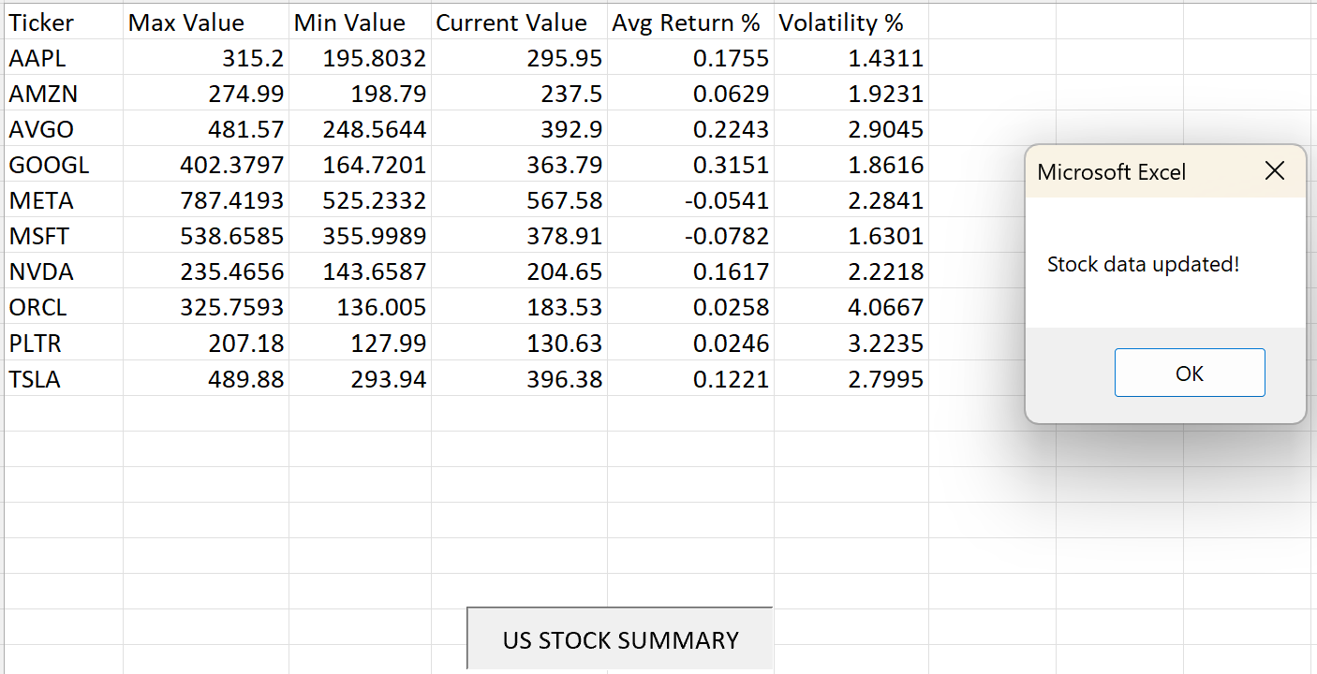
Excel Automation Using VBA
Request-Response Flow
User Clicks “US STOCK SUMMARY” button"
1
Triggers refresh via Power Query or VBA macro
Excel Sends HTTP Request
2
Via VBA, Office Scripts, or Power Query Web connector
API Computes & Returns JSON
3
Backend recalculates all stock metrics on demand
Excel Updates Worksheet
4
Table, charts, and dashboard refresh automatically

Slide 11
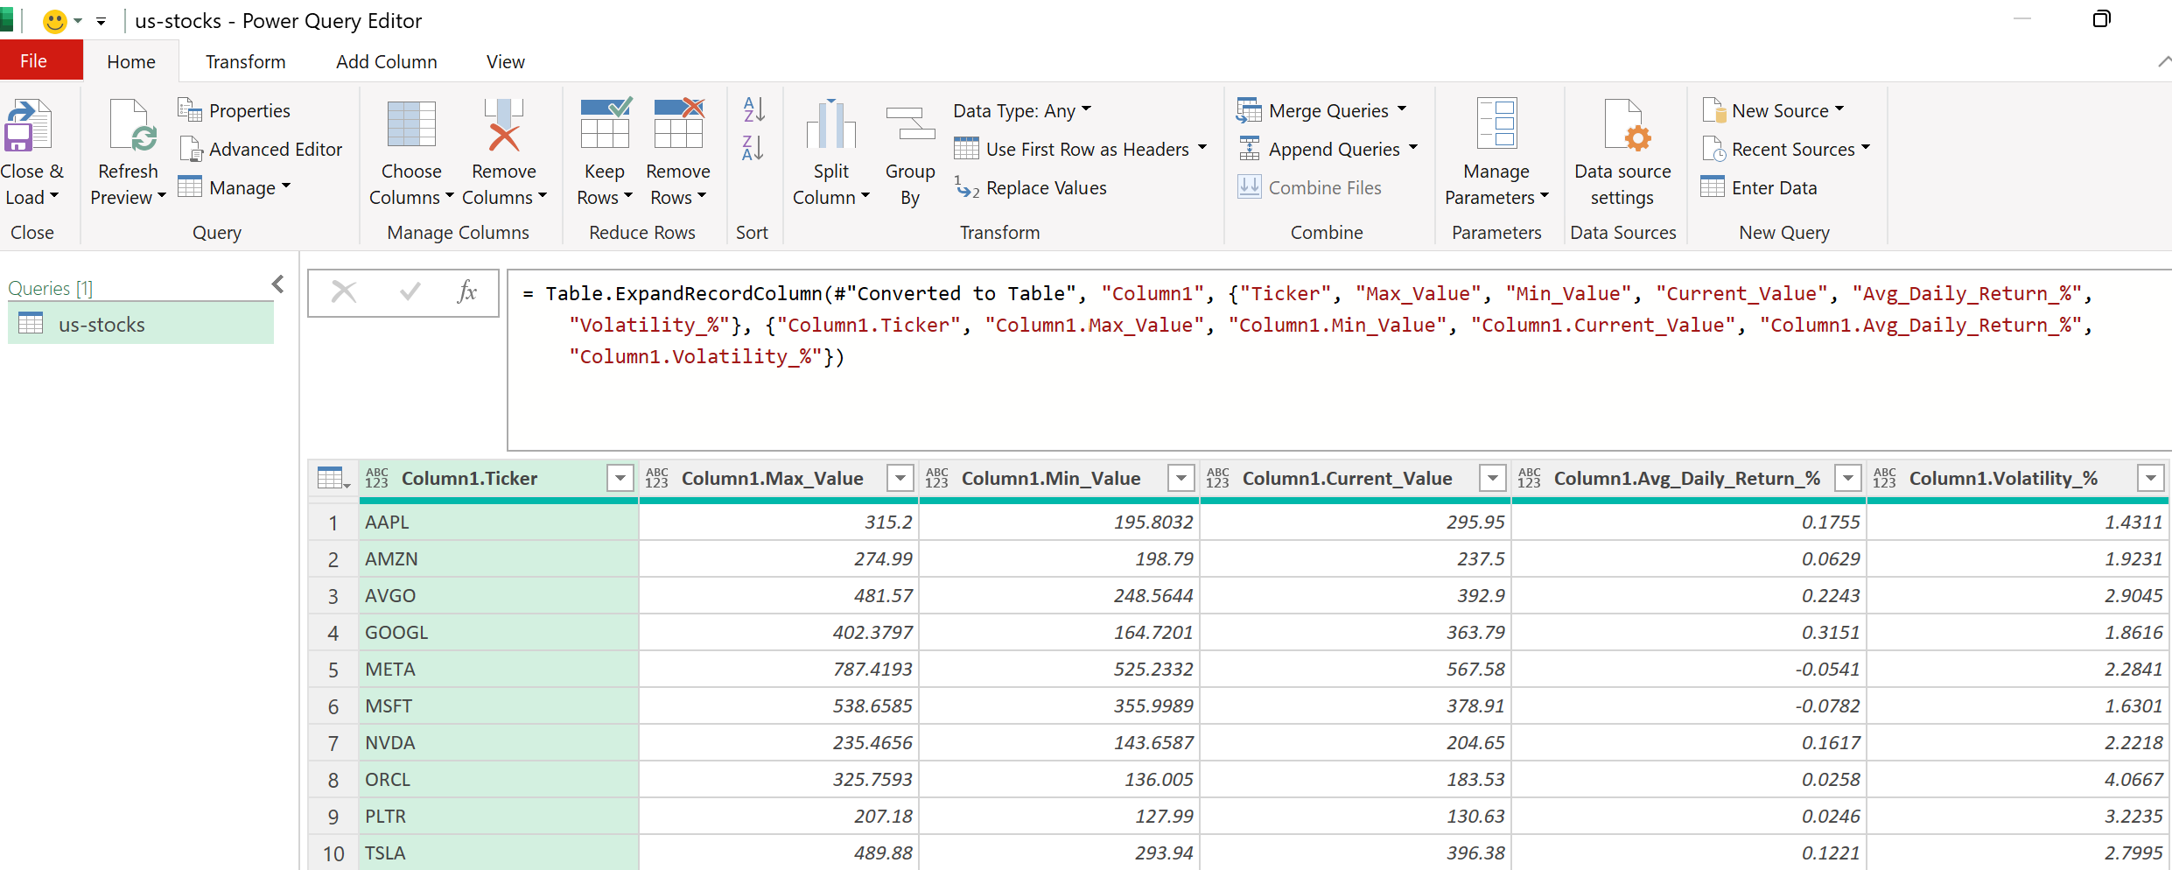
Excel Automation Using PowerQuery
The goal is simple: enable business users to fetch live stock analytics directly in Excel — without writing a single line of VBA or Python. By connecting Excel to a FastAPI endpoint via Power Query, users get a fully automated, refresh-ready dashboard out of the box.
Live Stock Analytics
The pipeline pulls data from the /us-stocks API endpoint, parses the JSON response, and converts it into a clean, structured Excel table
all managed by Power Query’s built-in transformation engine.
Note: Step-by-step instructions for both Excel VBA and Power Query are provided in the attached Word document. Power Query is the recommended path for a more robust, maintainable, and refresh-friendly solution.

Slide 12
Live Data Refresh in Excel
Once connected, Excel becomes a dynamic analytics dashboard. The refresh cycle is fully automated — users interact with a familiar spreadsheet while the backend handles all computation silently.
1. Click Refresh All
2. Backend Recomputes
3. Excel Updates
Re-runs the API call to the FastAPI backend endpoint with a single user action.
All metrics are recalculated fresh from live market data on every request.
Worksheet tables and all linked charts refresh automatically with zero manual steps.
This workflow supports daily reporting, market monitoring dashboards, and automated analytics pipelines — all driven from a single Excel workbook.

Slide 13
Using Excel Charts for Visualization
After Data Loads — Chart Options
Key Advantage
Create charts directly from API output to visualize analytics without any additional tooling:
Familiar charting tools empower non-technical users to explore data insights independently. No Python knowledge, no BI licensing, no new software — just the spreadsheet they already know.
Data teams maintain full control of the logic while business users retain full control of how they visualize and present it — a clean division of responsibility that scales across teams.
Bar chart → volatility comparison across stocks
Line chart → price trends over time
Pie chart → portfolio composition breakdown
Business users can analyze results without knowing Python, achieving a clean separation between computation (backend) and visualization (Excel).

Slide 14
Automating Workflow with Excel + API
Multiple automation options enable hands-free analytics delivery — from scheduled refreshes to event-triggered backend actions. Choose the approach that fits your team's tooling and technical maturity.
Scheduled Refresh
Button-Based Refresh
Power BI or Excel Online can refresh on a predefined schedule — hourly, daily, or weekly — without any user interaction.
Office Scripts trigger API calls on demand. A single button in the worksheet gives users full control over when data updates.
VBA Macro Integration
Backend Actions
Custom macros automate complex workflows — chaining API
calls, formatting output, and distributing reports automatically.
The API can also save results to a database, generate PDF reports, or trigger alerts — all transparently, on each call.

Slide 15

Key Takeaways
This project demonstrates that production-grade analytics doesn't require complex BI platforms. A well-structured FastAPI backend paired with Excel can deliver real-world value quickly and accessibly.
API Integration Skills
Backend Services Power Dashboards
You now understand how APIs connect Python analytics to business tools like Excel — enabling seamless data delivery across teams without requiring end users to touch any code.
FastAPI backend services handle computation, validation, and serialization, turning Excel into a live analytics dashboard that refreshes on demand.
Real-World Deployment
Automation Is Central
Moving beyond Jupyter notebooks into production systems means exposing logic via HTTP — reusable by any client or tool, from Excel to mobile apps.
Scheduled refreshes, VBA triggers, and button-based workflows eliminate manual effort and reduce reporting errors at scale.
Bottom line: Python handles the logic. FastAPI exposes it. Excel delivers it. Together, they form a lightweight, production-ready analytics stack that any organization can adopt today.

